Slide 1
Introduction To Web Design I
By Paul Kisambira
Email pkisambira@ucu.ac.ug
Mobile:0706177950

Slide 2
What is Technology
Not just using computers
Learning a new way to think
Understanding hardware, software, processes
Fundamental strengths and weaknesses of computing devices

Slide 3
Grading
Course Requires:
Heart to learn
Practice
Final grade =
50% written exam +
50% Tests and Course work + Group work

Slide 4
What is Technology
Not just using computers
Learning a new way to think
Understanding hardware, software, processes
Fundamental strengths and weaknesses of computing devices

Slide 5
Goals
Evolution of the technology
How the web fits in
Identify Key Terms
What is the Internet & what is the WEB
Protocols
HTTP review and details

Slide 6
Internet, Packets and Routing
Internet is a network of computer networks
Data is transmitted by packet switching using the standard Internet Protocol (IP)
Packet – a unit of information carriage
Packet switching – process of moving packets from one node (computer device) to another

Slide 7
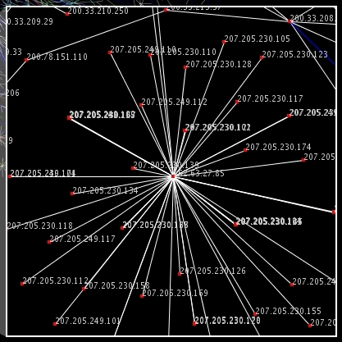
A Visualization of Internet

Slide 8
Internet, Packets and Routing
At the sender, data is broken into packets and sent to the nearest node (router)
At each router, it sends the packet to another router that is closer to the final destination
At the receiver, packets are reassembled to get the original data
A simple analogy: Taxi transport system

Slide 9
TCP/IP and Domain Names
Basic task of IP – moving packets as quickly as possible from one router to another
Yet, it doesn’t check whether packets are delivered successfully, thus need TCP
TCP (Transmission Control Protocol) – disassemble/reassemble packets, error checking, ACK packets

Slide 10
TCP/IP and Domain Names
We need some sort of address in order to identify different nodes, as if every house has a mailing address in order to receive mail from others
The one used by Internet Protocol is called IP address
Every host on the Internet has a unique IP address, made up of four numbers. E.g.. 192.56.215.131, each number is between 0 and 255

Slide 11
TCP/IP and Domain Names
The numbers in an IP address is hard to remember, while names are easier
Domain Name System – a mapping between the human-readable name (domain name) of a host and its IP address
A domain name consists of two or more parts, e.g. www.ucu.ac.ug
The rightmost label conveys the top-level domain, e.g. .ac.ug or .com

Slide 12
TCP/IP and Domain Names
Each label to the left specifies a subdomain, in our example, subdomain is ac(academic institution), and sub-subdomain is ug(Uganda).
A top-level domain contains of multiple subdomains, each subdomain can contain multiple sub-subdomain, so on.
The database contains the mapping between a domain name and an IP address is stored on a DNS server.

Slide 13
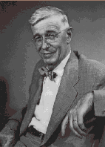
History of the World Wide Web
In 1945, Vannevar Bush (Science Advisor to president Roosevelt during WW2) proposes Memex.
Memex is conceptual machine that can store vast amounts of information, in which users have the ability to create information trails, links of related texts and illustrations, which can be stored and used for future reference.

Slide 14
History of the World Wide Web
In his view, Memex would act like the human mind which uses an “association of thoughts, in accordance with some intricate web of trails carried by the cells of the brain. ” Vannevar Bush

Slide 15

History of the World Wide Web
Theodore Nelson coins the term Hypertext, Hypermedia and World Wide Web.
Ted Nelson is also know for conceptualization of "Xanadu," a central, pay-per-document hypertext database encompassing all written information, which has never gotten off the ground.

Slide 16

History of the World Wide Web
The first working hypertext system was developed at Brown University in 1967, by a team led by Andries van Dam.
The Hypertext Editing System ran in 128K memory on an IBM/360 mainframe and was funded by IBM, who later sold it to the Houston Manned Spacecraft Center, where it was used to produce documentation for the Apollo space program.

Slide 17
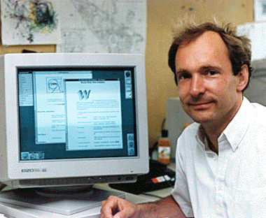
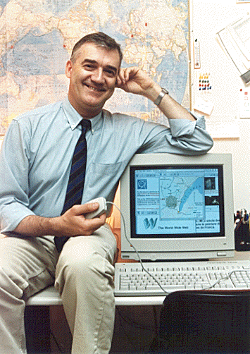
History of the World Wide Web
In 1990, Robert Cailliau and Tim Berners-Lee at CERN develop hypertext in order to allow scientist working in particle physics to exchange information and distribution of information over the Web begins.

Slide 18
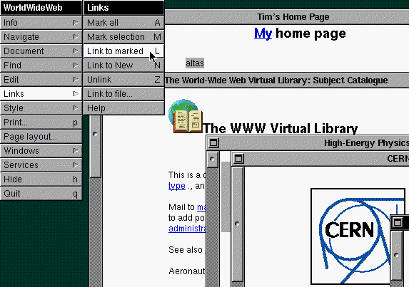
History of the World Wide Web
In 1992, CERN develops the first Graphical Browser.

Slide 19
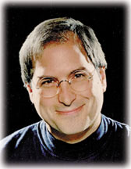
History of the World Wide Web
The computer used for the development of Hypertext was a NeXT Internet machine developed by Steve Jobs, one of the founders of Apple Computers. Jobs was asked to return to Apple Computers in 1997 and the NeXT operating system is the basis of the current Mac OS.

Slide 20
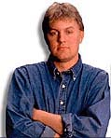
History of the World Wide Web
In 1993, Mosaic is released by the National Center for Supercomputing Applications (NASA) at the University of Illinois.
This graphical browser was developed by Marc Andreessen, a college student and part-time employee of NASA.

Slide 21
History of the World Wide Web
In 1994, Marc Andreeseen leaves NASA to set up his own company, Mosaic Communications Corp. (now Netscape Corp.) and hires all of the developers of Mosaic away from NASA.

Slide 22
History of the World Wide Web
1994, the first International WWW (W3C) Conference is held. Later the same year, the WWW Conference Committee is formed.

Slide 23
World Wide Web
The World Wide Web (commonly shortened to the Web) is a system of interlinked, hypertext documents accessed via the Internet.
It is created to share files/documents and overcome the barrier of different file formats
Hypertext refers to text on a computer that will lead the user to other, related information on demand.

Slide 24
World Wide Web
Accessing cross-referenced documents, known as hypertext linking, is probably the most important aspect of the Web because it allows you to quickly open other Web pages
A hypertext link, or hyperlink, contains a reference to a specific Web page that you can click to quickly open that Web page

Slide 25
World Wide Web
hypertext documents are created using a special kind of document formatting or “markup” language called HyperText Markup Language (HTML).
HTML is sent or received over the network using HyperText Transfer Protocol (HTTP).
A browser is a software program which interprets the HTML documents and displays it on the user’s screen.

Slide 26
World Wide Web.definitions
A Web site refers to the location on the Internet of the Web pages and related files (such as graphic files) that belong to a company, organization, or individual
A markup language is a set of characters or symbols that define a document’s logical structure or how a document should be printed or displayed

Slide 27
World Wide Web. definitions
A document on the Web is called a Web page, identified by a unique address called the Uniform Resource Locator, or URL
URL commonly referred to as a Web address
Each document/resource on the WWW needs to have an identifier in order to be accessed by others

Slide 28
URI and URL
A Uniform Resource Identifier (URI), is a compact string of characters used to identify or name a resource.
A Uniform Resource Locator (URL) is a URI which provides means of obtaining the resource by describing its network “location”.

Slide 29
URLs and Client-Server Model
Two things are given by the URL
Exact location of the document
The method or protocol by which to retrieve and display the document
Example, http://www.ucu.ac.ug/IT/web/index.html
http:// – specifies the protocol
www.ucu.ac.ug – specifies the host name / domain name
/IT/web/index.html – specifies the path of the document on the host

Slide 30
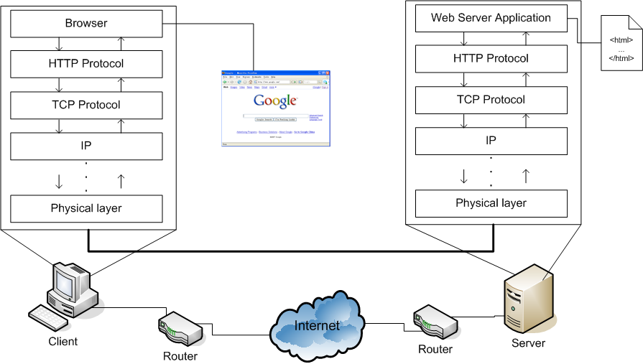
Putting it All Together

Slide 31
References(further reading if interested):
History of the Internet: Chapter 1 by Gregory Gromov — http://www.netvalley.com/cgi-bin/intval/net_history.pl
History of the Internet: Chapter 2 by Gregory Gromov — http://www.netvalley.com/cgi-bin/intval/net_history.pl?chapter=2
How it Really Happened by Robert Cailliau — http://www.computer.org/internet/v2n1/cailliau.htm
Leonard Kleinrock's Personal History/Biography The Birth of the Internet – http://www.lk.cs.ucla.edu/LK/Inet/birth.html
The Real History of the Internet by Christopher D. Hunter — http://www.asc.upenn.edu/usr/chunter/agora_uses/chapter_2.html

Slide 32
Any Questions

